Slide 1


Leading AI Driven Transformation
by Akshay Damodar

Slide 2
The Rise of AI: Opportunities and Challenges
Opportunities
Challenges
AI is revolutionizing industries, automating tasks, and providing valuable insights.
Ethical concerns, data privacy issues, and workforce adjustments are key considerations.

Slide 3

Defining a Clear Vision and Strategy for AI Transformation
1
1. Define Goals
2
2. Identify Use Cases
Identify specific business goals to be achieved with AI.
Explore potential applications of AI to address business challenges.
3
3. Develop Roadmap
Outline a phased approach for implementing AI solutions.

Slide 4



Aligning AI with Business Objectives and Customer Needs
Customer Needs
1
Understanding customer expectations and pain points.
Business Objectives
2
Connecting AI initiatives to strategic goals.
AI Solutions
3
Developing AI solutions that address both customer needs and business objectives.

Slide 5




Establishing Agile Project Management Practices
Timeboxing
Collaboration
Breaking down projects into smaller, manageable sprints.
Encouraging cross-functional teams to work together.
Iteration
Continuously evaluating and improving solutions based on feedback.

Slide 6
Developing an AI Governance and Risk Mitigation Framework
Data Privacy
1
Establishing clear policies and procedures for data handling.
Bias Mitigation
2
Implementing measures to ensure fairness and equity in AI systems.
Transparency and Accountability
3
Ensuring transparency in AI decision-making processes.

Slide 7
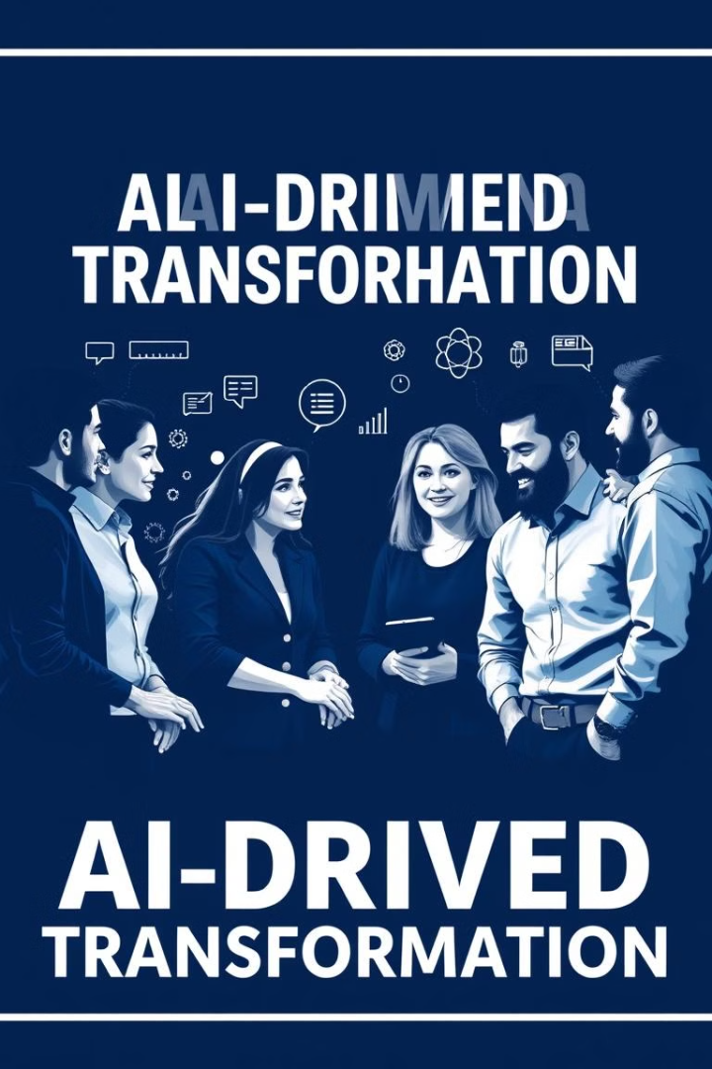
Building a Network of Transformation Champions
1
Identify Leaders
Identifying individuals passionate about AI and its potential.
2
Empower Champions
Providing champions with resources and opportunities to lead.
3
Foster Collaboration
Creating a network of champions to share knowledge and best practices.

Slide 8

Upskilling and Reskilling the Workforce for the AI Era
1
2
3
Technical Skills
Soft Skills
Ethical Considerations
Training in data science, machine learning, and AI development.
Developing critical thinking, problem-solving, and communication skills.
Understanding the ethical implications of AI and responsible use.

Slide 9

Embedding a "People-First" Mindset in the Transformation
Employee Engagement
Reskilling Support
Involving employees in AI initiatives and addressing their concerns.
Providing resources and guidance for employees to adapt to new roles.
Ethical Considerations
Prioritizing ethical AI practices that benefit all stakeholders.

Slide 10



Key Takeaways and Next Steps

